Slide 1
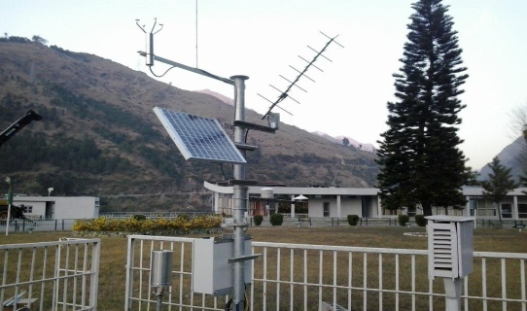
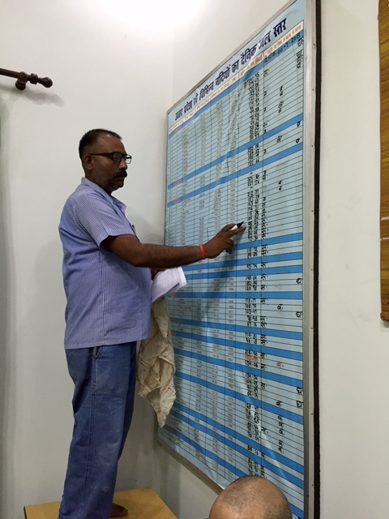
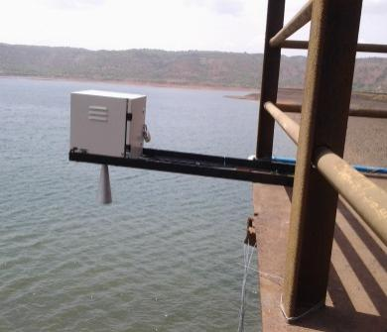
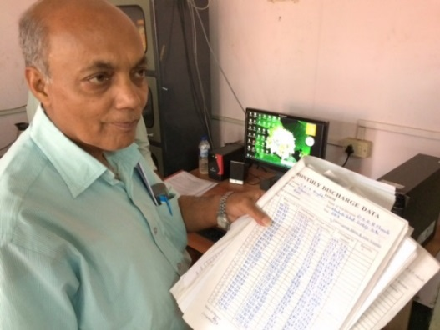
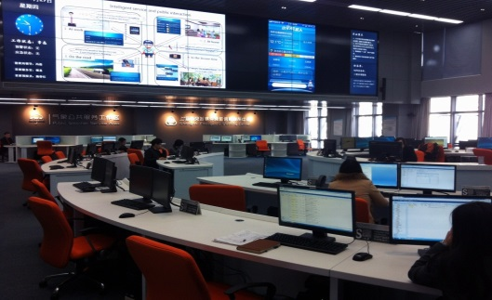
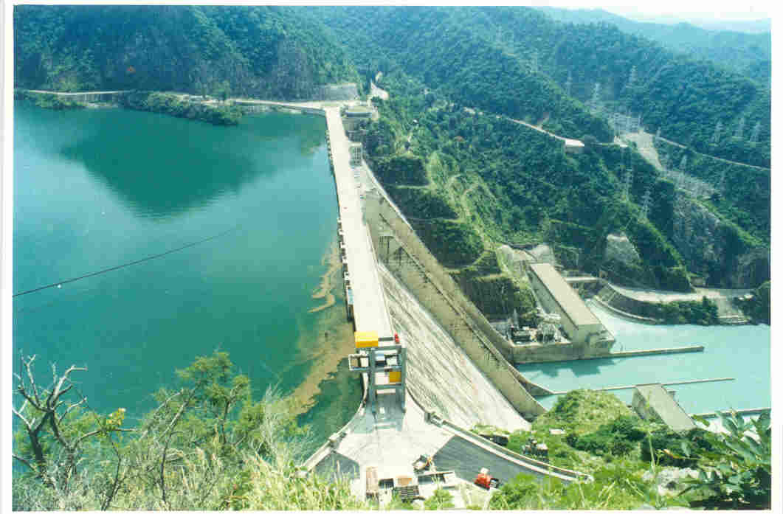
National Hydrology Project:
Integrated Water Resources Management
September 2015
RELIABLE, TIMELY, QUALITY, CONSISTENT, PUBLIC DATA
(www.indiawrm.org)

Slide 2

Concepts of National Hydrology Project
Standardizing Water Resources data and Information System for the country with uniform procedures and database.
Integration of River basin information with improved access to Centre, States and Public-domain.
Introducing country wide generic solutions for flood forecasting and River basin based water management.
Developing site specific solutions for water resources planning, operation and management including use of remote sensing based techniques.
2

Slide 3
NHP: Project Details
Project Objective:
To improve water resources planning and management across India by enhancing the scope, coverage and reliability of water resources information and strengthening the Water Resources institutions.
Project Components:
Water Resources Data Acquisition System (WRDAS)
Water Resources Information System (WRIS)
Water Resources Operation and Planning (WROP)
Institutions Capacity Enhancement
Budget Outlay: INR 3640 (USD 250 M World Bank)
Effectiveness: Feb 2016 ?

Slide 4
Fund Allocation Component-wise
Components | State Agencies | Central Agencies | Total | %
A | 1442 | 145 | 1587 | 44
B | 120 | 399 | 519 | 14
C | 360 | 247 | 607 | 17
D | 481 | 411 | 891 | 25
Total | 2403 | 1201 | 3604 | 100
Contingency= INR 36 crore
The allocations to components will remain fix however there is enough flexibility among the components to accommodate various needs. Change during MTR…

Slide 5
Potential Economic Benefits
Investment: Rs. 3,640 cr NPV of benefits (25 yrs: 12%) Rs. 31,989 cr
NPV (10%) Rs. 43,131 crores Financial IRR 47%
Annualized benefits: Over 17 years, these are benefits (in crore rupees) per year, from investments supporting the NHP
  Annual investment: INR 300 crore
  Potential measurable Benefits > INR 2,000 crore

Slide 6
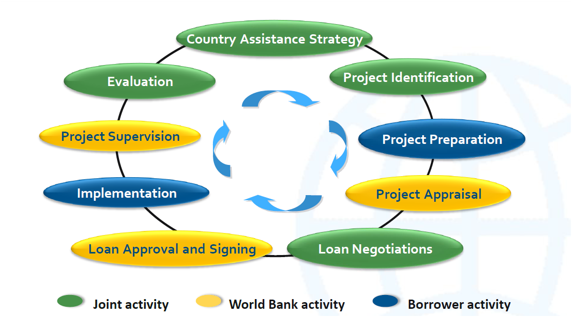
World Bank Project Cycle
Sep: We are here
EFC
?????
Cabinet
Dec 2015
DEA Readiness?

Slide 7
DEA Readiness
1. Project management units (PMU) at each agency should be strengthened in line with project requirements.
2. Thirty percent (>600 crore) of procurement should be ready to be awarded.
3. Major consultancies (>INR 200 crore) for the first two years of the Project should be awarded prior to effectiveness.
It would require at least 3 months to reach the readiness…target.
7

Slide 8
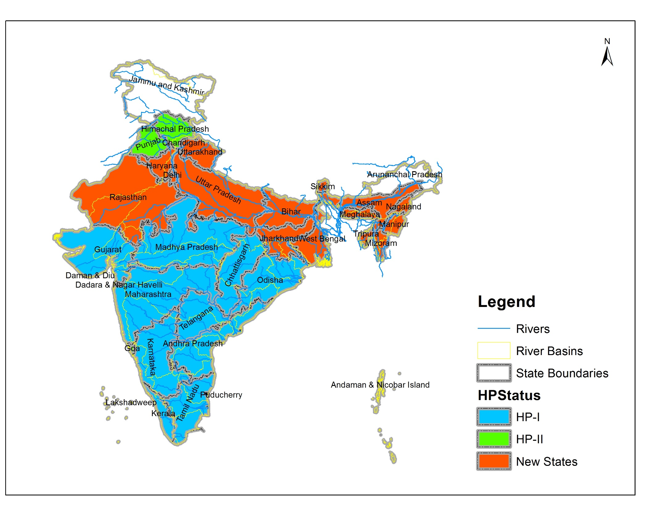
River Basin State map
Implementing Agencies | HP2 | New | Total
States | 19 | 17 | 36
UT | 1 |  | 1
Central agencies | 6 | 2 | 8
RBO | 1 | 1 | 2
Total | 27 | 21 | 47

Slide 9
DEA Readiness: Criteria 1 (PMU)
Agencies | HP2 | New | Total | Institution Readiness
States | 19 | 17 | 36 | 30
UT | 1 |  | 1 | 1
Central agencies | 5 | 3 | 8 | 1
RBO | 1 | 1 | 2 | 2
Total | 27 | 20 | 47 | 34
SPMU in 6 state agencies are yet to be strengthened: Haryana, Bihar GW, Orissa SW/GW, Uttarakhand; Tripura not active.
Responding to the critical needs but no dedicated team to guide the states and prepare the project. Central Agencies PMUs in central agencies to be assigned. SoI has not indicated any active interest, so back up arrangements need to be made.
9

Slide 10
DEA Readiness: Criteria 2 (Procurement)
Agency | Type | Value of procurement (Crore) | Status/ Time required | Time required
MoWR/ CWC | Framework agreement of Hydromet | 800 | Specifications are ready | 3 month
States | Hydromet and SCADA | 66 | 50 % of bids document are getting ready.* | 3 months
States (6) | Data centers (Bldg) | 42 | No progress | 4 months
Total |  | 108
New States (NE) are requiring data centers, could bid using Himachal Pradesh example.
Hydromet and SCADA: MH , RJ, UP, KE, TN, WB can make bid documents ready in one month.
* Procurement can not be initiated till Budget line is created by the IAs.
10

Slide 11
DEA Readiness: Criteria 3 (Consultancies)
Agency | Type | Value of procurement (Crore) | Status/ Time required | Time required
MoWR | TAMC | 100 | TOR is in draft stage | 5 month
CWC | River basin FF and River assessment | 100 | TOR is in draft stage | 5 month
States | Studies | 7 |  | 5 months
Total |  | 250
Goa and TE have also proposed some studies.
Other states also need help but they will need help in preparing TORs.
11

Slide 12
Retroactive Financing
Retroactive financing is permissible for agreed expenditures incurred in the year prior to project signing date, provided procurement is compliant with World Bank procedures.
This would apply to the activities implemented during one year prior to signing of project. For instance if the project signed on April 1, 2016, retroactive financing would be available for the activities implemented during April 1, 2015- March 31, 2016.
Line budget item of states yet to be included (some states have already done: ~5 agencies).
12

Slide 13
Critical action required
MoUs with the IAs: The data integration and access protocol between India WRIS& State WRIS, Real time data flow through E-SWIS, E-GEMS. Architect of IndiaWRIS and facilities for SWRIS.
River basin level Data integration and access protocol for classified and non-classified basins.
Procurement and Financial Manual
Final PIP preparation (including GO orders)
Coordination needed for
Implementation arrangement to avoid duplication of River Basin models (CWC, NIH, NRSC, and States).
Center of excellence arrangements where and how?
13

Slide 14
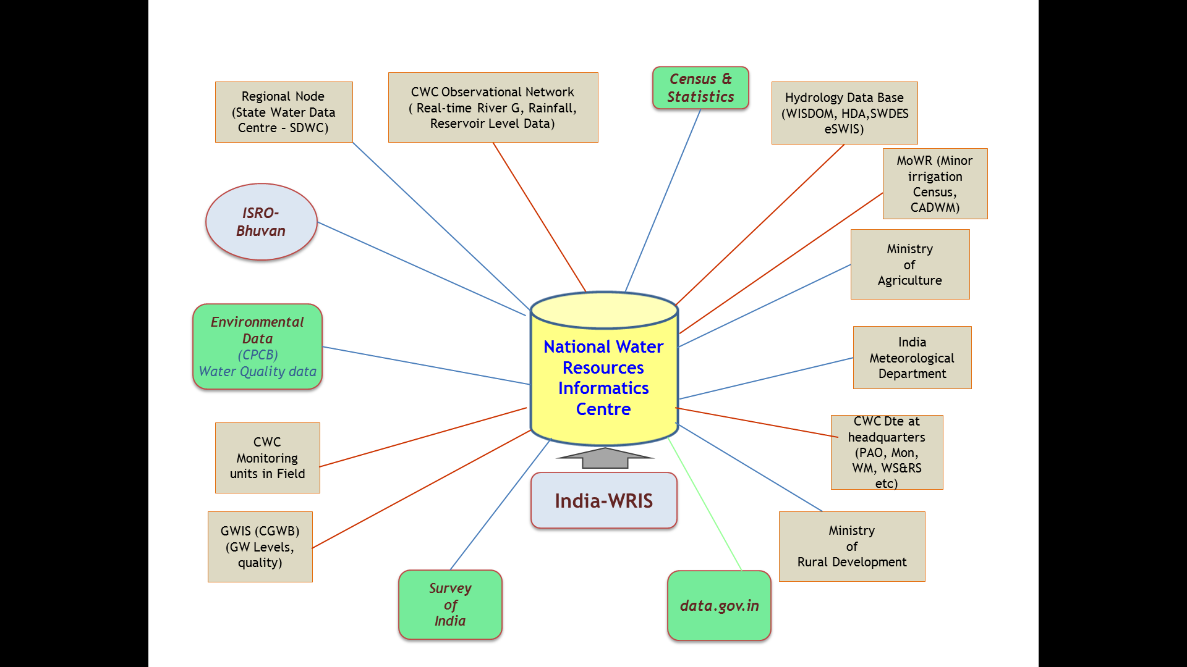
India-WRIS/NWIC
Creation of State Nodes of India-WRIS
Development of Web Services
Support for creation of State-WRIS: Prepare Standard and Protcols
Linkages of various models/outputs

Slide 15


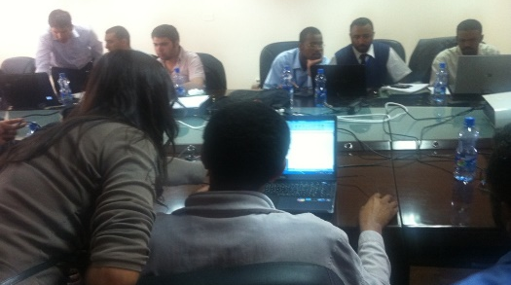
D1. Water Resources Knowledge Centre
  River basin modelling centers (river basins to pilot ):
  - Krishna
  - Mahanadi
  - Damodar
  - ??
  Groundwater modelling center (Selective region/issue):
  - Hardrock – AP/Telangana
  - GW modelling center at CGWB
  - Alluviam ??
  Centre of Excellence for Water Management
    - North East Centre of Excellence for Water – Guwahati
    - ??
Facilitate knowledge exchange:
  - With internationally reputed Institutes
  - States may consider reforming WALMIs/IMTI
The Institutional arrangement : how “excellent” team will be continued even after the project

Slide 16
Are Project activities centralized?
River Basin Assessment and Flood forecasting:
Both central and State level modelling activities are included.
Central shall work on Macro River Basin while states will setup for sub-basin and will actively participate in Macro RB.
For instance: In Krishna Basin, MH has set up for Upper Bhima and Krishna, now CWC can integrate for interstate Krishna Basin Main river. However, if lower riparian, KT, AP/TE also want to set up for their tributaries and/or for entire basin, they can develop as well.
Similarly, West Bengal being lower Riparian can start to setup FF for the their River basins in consultation with upper Riparians and CWC.
16

Slide 17
Are Project activities centralized?
Training:
Although NIH is the nodal agency, States are encouraged to collaborate with reputed Institutes and even develop training program.
NIH can be informed so that they can also think of using same system and help others to learn.
It means states are also welcome to take the lead!
17

Slide 18
Are Project activities centralized?
Hydromet procurement:
There is a plan to introduce Framework agreement by central, however till then States are advised to proceed with full Hydromet bid document and commence processing.
Framework Agreement would facilitate technical evaluation by shortlisting makes and models of sensors.
WQ Lab and Geophysics Equipment
Framework Agreement- With assistance from DGS&D (Rate contract).
18

Slide 19
Technical support and Manpower
MoWR is expected to provide Hydromet Experts at regional level for close consultation to the states through TAMC.
NIH is being requested to provide Modelers in each state so that they can help setting up river basin database and models under their guidance. However if some states are capable of having their own, they are welcome to do so.
Some states have system having contract staff that will be covered under Operating cost.
However, there are large number of states which are not permitted contract staff, there are two means:
  Hire through HR agency
  Collaborate with Academia/R&D/regional RS centers.
19

Slide 20
PIP
States need help in strengthening component C activities. MoWR and NIH is requested to work with the states to map the issues and the studies required.
State may please note:
Project will not fund structures such as recharge or check dams.
Old states should minimize establishment of new observation station, and construction of buildings.
Instead, community based monitoring to populate the data particular for GW based monitoring, tank monitoring etc.
State are lacking in Community based monitoring and management program.
Crowd sourcing also need to be introduced in IndiaWRIS and states need to learn it more.
20

Slide 21
Project Timeline
S. No. | Activity | Agency | Due by | Status
1 | Finalize detailed PIP | IAs | Sep 30, 2015 | Prelim PIP:90% agencies. Agencies need to now revise in line with revised allocation. 30% agencies have submitted already.
2 | Finalization of PIP by MoWR | MoWR | Nov 15, 2015 | Compile from State including revised cost tab
3 | Submission for EFC clearance | MoWR | Sep 2015 | Consent received from the Project
4 | EFC Clearance | MoWR | Oct 2015
5 | Project Appraisal | WB | Nov 2015
6 | Negotiation | WB/ MoWR | Dec 2015 | It will depend on DEA Readiness.
7 | WB Board for clearance | WB | Jan 2015
8 | Cabinet Clearance | MoWR | Feb 2016
9 | Effectiveness |  | Feb, 2015

Slide 22
DEA Readiness for project
S. No. | Key activity/ milestone | Timeline | Status
1 | Allocations to IAs | Sep 2015 | Allocations have been shared. Funding arrangements however will be finalized after EFC.
2 | Institutional Arrangement | Immediately | MoWR and 30% state agencies need to strengthen. TMC consultancy needs to initiated.
3 | Procurement plan approved | Sep 2015 | 50% agencies have submitted
4 | Preparation of TORs, DPRs and bid documents | Sep 2015 | Some agencies have in advance stage but needs MoWR staff to review and guide them.
5 | Approval of bid documents and tendering | Oct 2015 | Bids pending from HP2 can be floated soon. Framework agreement for Hydromet needs to initiated soon.
6 | Award of consultancies | Dec 2015 | MoWR: TAMC CWC: River Basin Consultancy
7 | 30% of tenders evaluated. | Dec 2015 | Needs to be ready to award soon after negotiation.

Slide 23
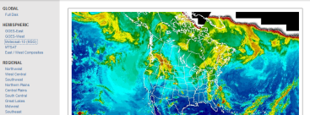
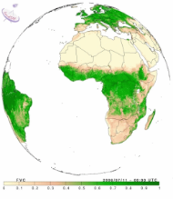
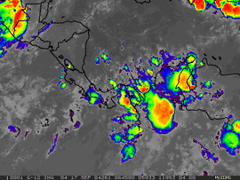
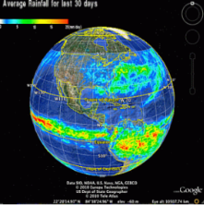
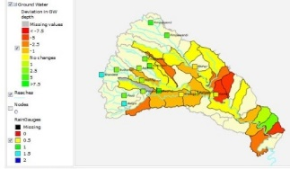

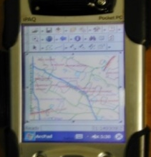
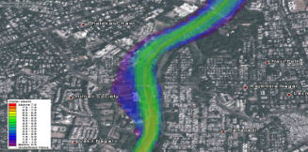



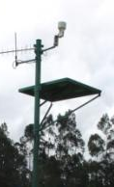
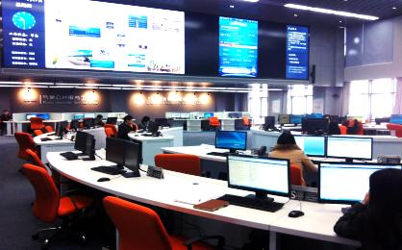
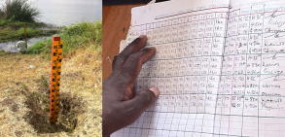
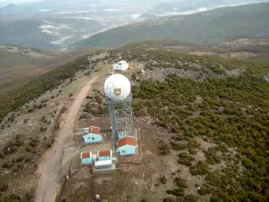
NHP Vision
B: Water Resources Information system
Web Portals
(e.g. integrated hydromet. visualization platforms)
Survey and
Digitization of GIS layers
Hydro Geomatic solutions: Earth Observation, Weather forecast, Terrain
DSS for IWRM
Earth observation data access via suitable mechanisms (e.g. Internet, GeoNetCast)
Stakeholder Outreach
Interaction with other Knowledge Base and Analytical Systems
National Water information Center
(State Chapters)
Dissemination Platforms
Crowd-sourced / Community Surveillance Data
DSS for Flood forecasting
Capacity Building and Centers of excellence
Real time data acquisition and Hydrological Repository
Reservoir Operation
Telemetry
C: Water Resources Operation and Planning
D. Institutional Strengthening and Capacity Building
Manual Monitoring
Automated Monitoring
Radars
A: Water DAS

Slide 24
OVERALL IMPLEMENTATION ARRANGEMENT
GLOBAL
THINK TANK
National Level HIS Steering Committee (NLSC)
Chaired by Secretary, MoWR,RD & GR
Policy Guidance
Strategic oversight
Resolve implementation issues with CA and States
HIS Financial Review Committee
Chaired by Addl. Secretary, MOWR, RD & GR
HIS Technical Review Committee
Chaired by Chairman, CWC
NATIONAL
LEVEL
Central HIS Management Unit (CHMU)
HIS COORDINATOR (Joint Secretary )
HIS NODAL OFFICER (Director MoWR)
Day to day management and coordination with CA and Sates
Monitoring and Reporting
Disbursements and Fiduciary management
Liaison with WB, International WR bodies
HIS CORE TECHNICAL SPECIALISTS, ADMN. AND FIDUCIARY SPECIALISTS
HIS Technical and Management Consultant (TAMC)
Central Agency HIS Management Unit (CAHMU)
CENTRAL AGENCY COORDINATOR (CE/MEMBER/DIRECTOR)
CENTRAL AGENCY NODAL OFFICER (Director/Jt. Director/Scientist G)
Implementing own programs
Technical Support to States
CWC- India WRIS, hydro-met; NIH- Capacity Building; CWPRS- Instrumentation; NRSC- Earth Observation Products, CGWB- ground water monitoring
Macro modelling
CENTRAL AGENCY
LEVEL
Dedicated staff for Own Program Implementation and State Support; Field Units
Technical Consultant
BASIN
LEVEL
BBMB/DVC
COORDINATING BODY IN NEW BASINS AND WITH REPRESENTATIVES OF RIPARIAN STATES
Avoid duplication of efforts by states
Integrate Basin level HIS
Coordination and collaboration for basin level assessment and modelling
State Level HIS Steering Committee (SLSC)
Chaired by Principal Secretary, MoWR/ID/GWD
State level Policy Guidance
Resolve implementation issues
Communicate with NLSC
RIPARIAN
STATE
LEVEL
State HIS Management Unit (SHMU)
State HIS COORDINATOR (Principal Secretary, MoWR/ID/GWD )
State HIS NODAL OFFICER (CE WRD/ID Assisted by Full time SE/Director-GWD)
Day to day Implementation of activities
Monitoring and Reporting
Work with CA
Collect, validate, upload data
Micro modelling
Dedicated Technical, Admn. And Fiduciary Specialist; Field Units
Technical Consultant

Slide 25
Centralized Support
Agency | A: Hydromet | B: WRIS | C: WR tools | D: Capacity Building
MoWR | -Provide Hydromet Experts in regional office | - Strengthen NWRIC Data integration protocol. MoUs for data/information integration among agencies |  | - Procure TMC. - Plan center of excellence - Collaborations with National and International Institutes.
CWC | - Framework Agreement Telemetry INSAT, VSAT, GSM Real time DAS arrangements | Upgrade E-SWIS for RTDAS and Prepare standard protocols for India WRIS for states. | Consultancy for Regional flood and Water Res models. | Establish regional FF and River Basin centers with States.
NIH | Training program in Hydromet | Training in web-based data display, survey , RS | - Coordinate PDS activities. - Provide WR modelers to each agency | -Center of Excellence for trainings - Online and classroom Training development.

Slide 26
Centralized Support
Agency | A: Hydromet | B: WRIS | C: WR tools | D: Capacity Building
CGWB | Guide in GW monitoring design and aquifer parameters. | Centralized GW database management (E-GEMS) | Guide in Aquifer mapping and other GW related studies. | GW modelling center.
NRSC |  | Remote sensing based applications | RS based WR applications for River basin and irrigation assessment. | Training in RS based applications
SoI |  | Coordinate Survey, and provide high resolution DEM
CPCB | WQ standards, WQ lab specifications | Centralized Database Management (EWQIS) | Studies on Water quality issues
CWPRS | R&D for Hydromet and SCADA

Slide 27
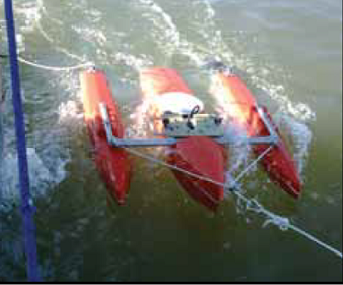
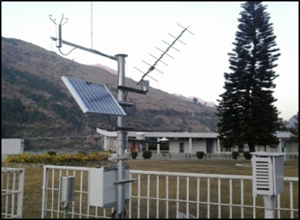
A: Water Resources Data Acquisition System
A1. Hydromet Observation
A2. Automated System Operation and Data Acquisition
A3. Hydro-Informatics Centers

Slide 28
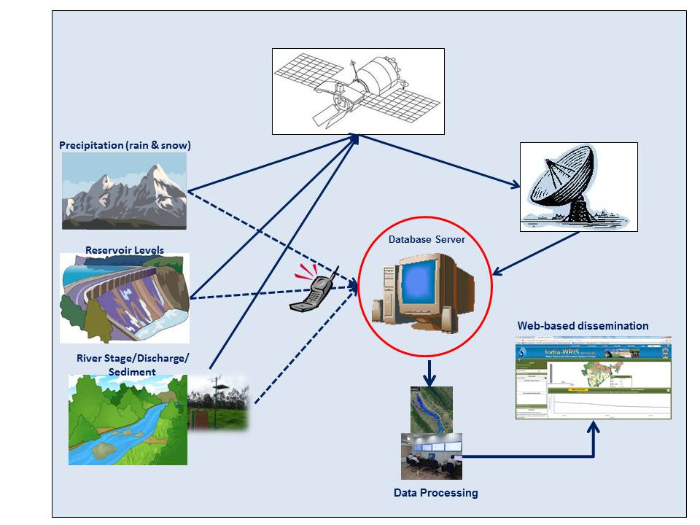
A1. Hydromet Observation

Slide 29
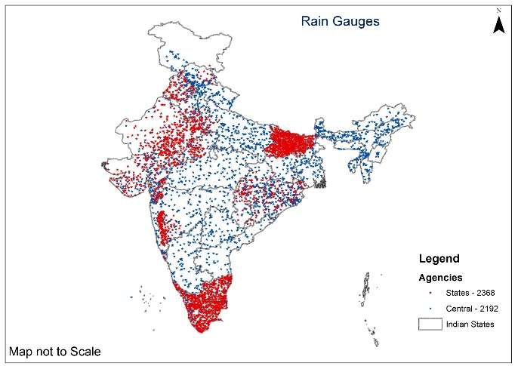
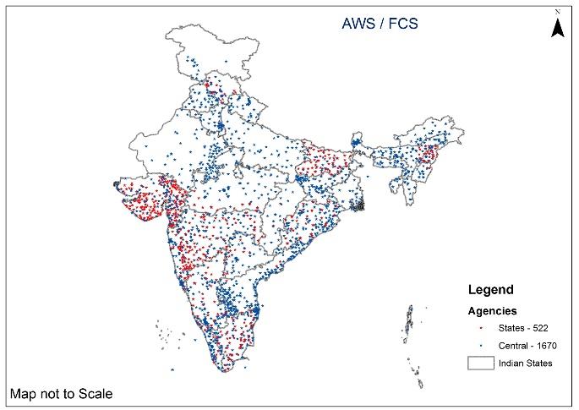
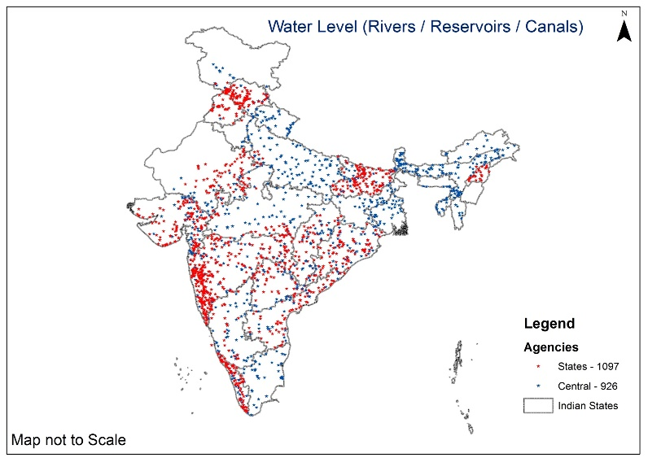
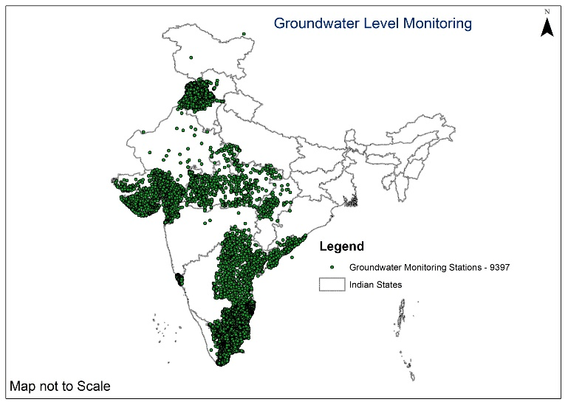
A1. Hydromet Observation
States are requested to

Slide 30
A1. Hydromet Observation
Proposed Hydro-met
Type of Station |  | Number
Automatic Rain gauges |  | 2452
Automatic Weather Stations |  | 559
Surface Water Level Monitoring | Rivers | 943
 | Dams / Barrages | 550
 | Canals | 423
 | Total | 1916
Ground Water Level Monitoring |  | 5744
Water Quality Sampling Sites |  | 1781

Slide 31
A1. Hydromet Observation Proposed
Agency | Rain Guage | Automatic Weather Stations | Water Level Monitoring |  |  |  | Ground Water Levels | Water Quality
 |  |  | Rivers | Dams / Barrages | Canals | Total
Andhra Pradesh | 45 | 4 | 72 | 0 | 0 | 72 | 925 | 925
Assam | 150 | 10 | 100 |  |  | 100 | 45 | 83
BBMB |  |  | 20 | 20 | 50 | 90 |  | 10
Bihar | 67 | 5 | 52 | 7 |  | 59
CGWB |  |  |  |  |  | 0 |  | 60
CWC | 140 | 30 | 100 |  |  | 100 |  | 25
Chattishgarh | 108 | 5 | 34 | 20 | 0 | 54 | 506 | 0
Goa |  | 5 | 4 |  |  | 4 | 50
Gujarat | 200 | 150 | 48 | 152 |  | 200 | 162
Haryana | 120 | 15 | 4 | 9 | 100 | 113 | 800 | 10
Karnataka | 500 | 40 | 23 | 10 | 10 | 43 | 0 | 2
Madhya Pradesh | 322 | 14 | 20 | 74 | 40 | 134 | 450 | 0
Maharashtra | 85 | 16 | 44 | 65 | 168 | 277 | 0 | 5
Manipur | 5 | 6 | 5 | 6 | 0 | 11 | 0 | 6
Meghalaya | 30 | 5 | 27 | 0 | 0 | 27 | 25 | 1
Mizoram | 32 | 12 | 13 |  |  | 13 | 10
Nagaland | 5 | 13 | 32 |  |  | 32
Odisha | 200 | 15 |  | 30 |  | 30 | 600
Puducherry | 10 | 0 | 7 | 0 | 0 | 7 | 5 | 2
Punjab | 0 | 1 | 15 | 1 | 1 | 17 | 600 | 1
Rajasthan | 143 | 73 | 30 | 40 | 25 | 95 | 150 | 154
Sikkim | 31 | 31 | 40 | 42 | 0 | 82 | 0 | 4
Tamil Nadu | 76 | 56 | 90 | 0 | 0 | 90 | 766 | 4
Telangana | 50 | 9 | 46 | 50 | 25 | 121 | 450 | 455
Uttarkhand | 36 | 20 | 34 | 6 | 4 | 44 | 0 | 34
West Bengal | 97 | 24 | 83 | 18 |  | 101 | 200

Slide 32
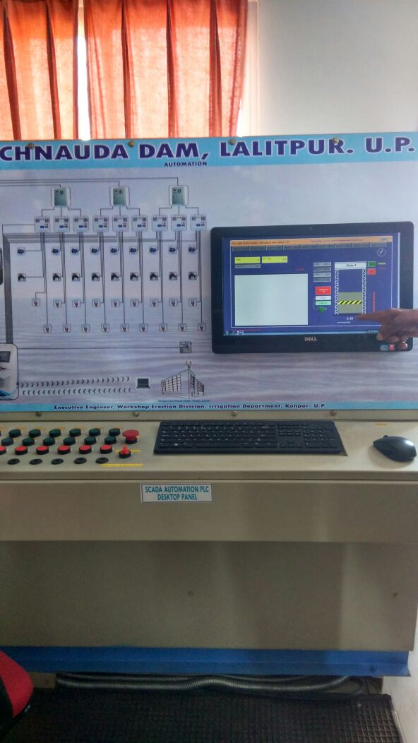
A2. Automated System Operation and Data Acquisition
Reservoir monitoring and automated Operation of gate
system for Reservoir/Barrages
UP
West Bengal
MP
Haryana
Canal Gate control system for major canal
MP, Rajasthan
  UP and West Bengal are in advance stage of preparation of Bid and others should prepare the bid documents

Slide 33
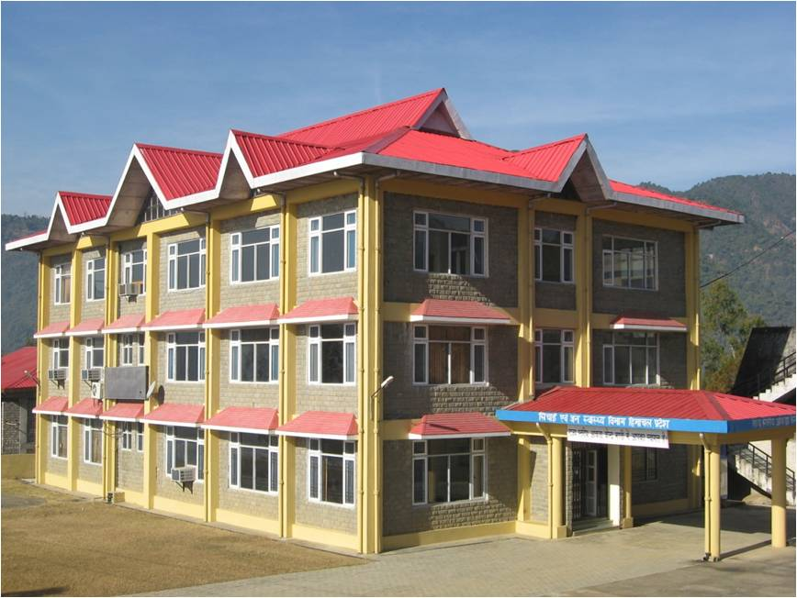
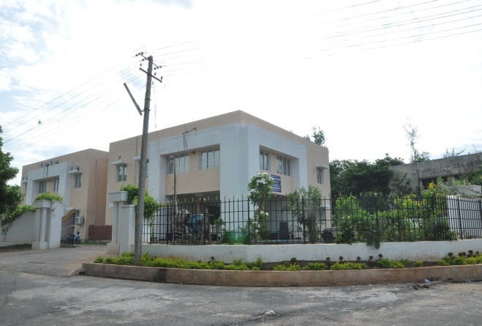
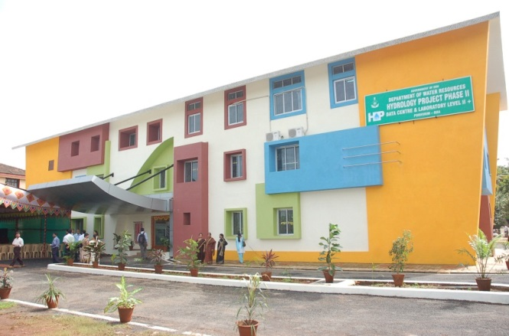
A3. Hydro-Informatics Centers
  All Data Centers Proposed (National, River Basin, State, Regional, District) must initiate the procurement process in the 1st Year of the Project
  All State Data Centers must be equipped with video conferencing systems

Slide 34
A: Water Resources Data Acquisition System
  MoWR:
  Technical support and quality control: Provide regional Hydromet experts for day to day guidance.
  CWC:
  Centralized Framework Agreement for RT Hydromet DAS (Framework agreement would shortlist the makes and models of sensors, and states will bid for financial quotation only), till it is finalized States are advised to prepare full bid document.
  Arrangements for telecommunication: INSAT/VSAT
  Upgrade eSWIS for RTDAS (INSAT, GSM, VSAT)
  Arrangements on real time dataflow with the states
  CGWB: Introduce Centralized software for RTDAS for DWLR
  NIH: Develop Hydromet Training program
  CWPRS: R&D
  States: Prepare bid documents of RTDAS for Package 1.

Slide 35

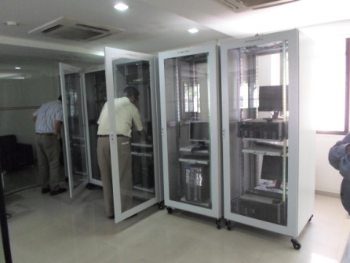
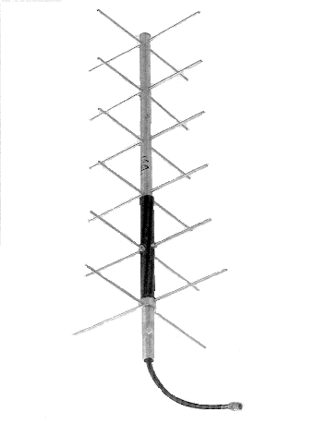
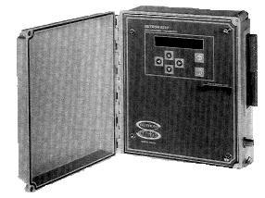
INSAT
Instantaneous Transmission to State Data Center
BURST \TDMA mode transmission
Satellite Down Link
YAGI
satellite antenna
Sensors
Data Collection Platform (DCP)
ERS at JAIPUR, BURLA
and DELHI
State Data Center
Server with eSWIS software
Other Data
Server with eSWIS software
Cloud server
Cloud server
Backup Server
Data flow using INSAT

Slide 36

Instantaneous Transmission to State Data Center
Sensors
Data Collection Platform (DCP)
State Data Center
Other Data
Server with eSWIS software
Cloud server
Backup Server
Data flow using VSAT

Slide 37
Instantaneous Transmission to State Data Center
Sensors
Data Collection Platform (DCP)
State Data Center
Other Data
Server with eSWIS software
Cloud server
Backup Server
Data flow using GSM

Slide 38
Advantages of using Centralized telemetry and software
Saving to State:
Set up cost
Earth Receiving Station = INR 1 Crore (CWC has three back up)
Software (eSWIS) = INR 1 crore
Operation cost = 20 lakh per year (10% of system)
In 10 years it would save almost = 2+0.20*10= INR 4 crore for a state
Automatic backup system with three ERS at CWC, would save data loss.
In case of INSAT, first landing point for station data would be CWC ERS at Delhi
In case of GSM/VSAT, the data would first land on server of State Data Centre

Slide 39
B: Water Resources Information System
B1.National Water Resources Information System
B2.State Water Resources Information System

Slide 40
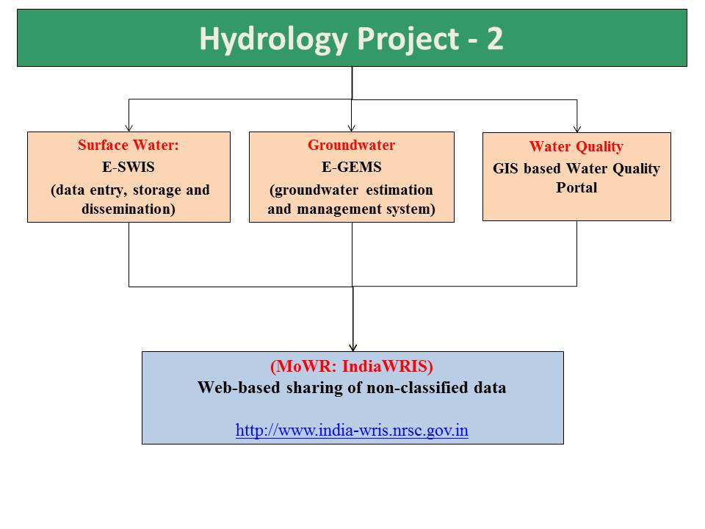
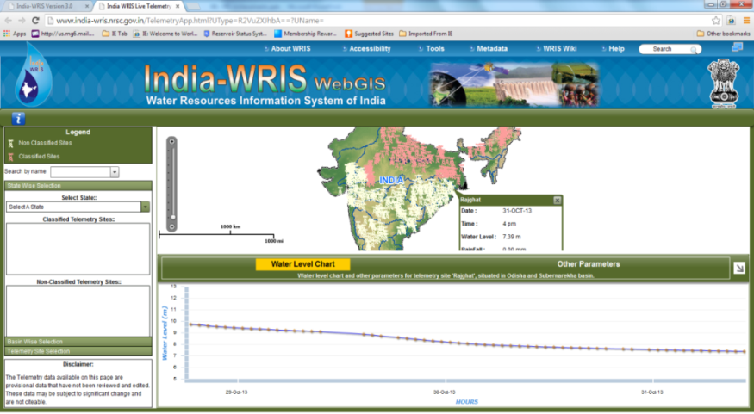
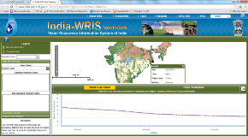
B1.National Water Resources Information System
National Hydrology Project
Database system for entry, storage, validation and visualization
National Web-based Platform for data dissemination to wider stakeholders
State WRIS

Slide 41
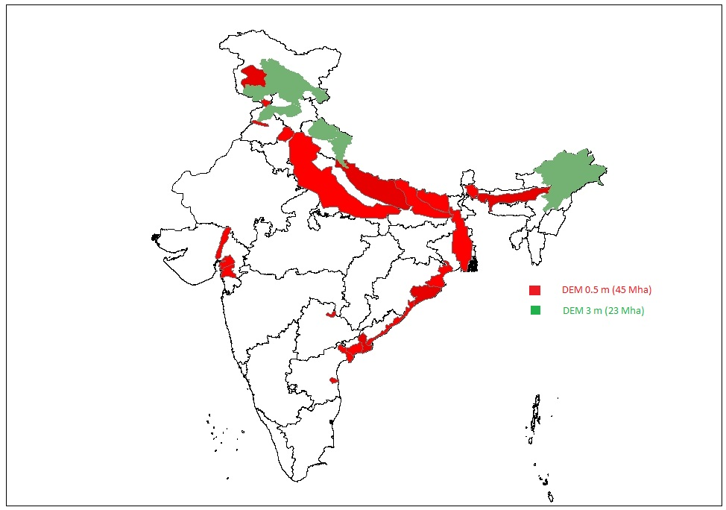
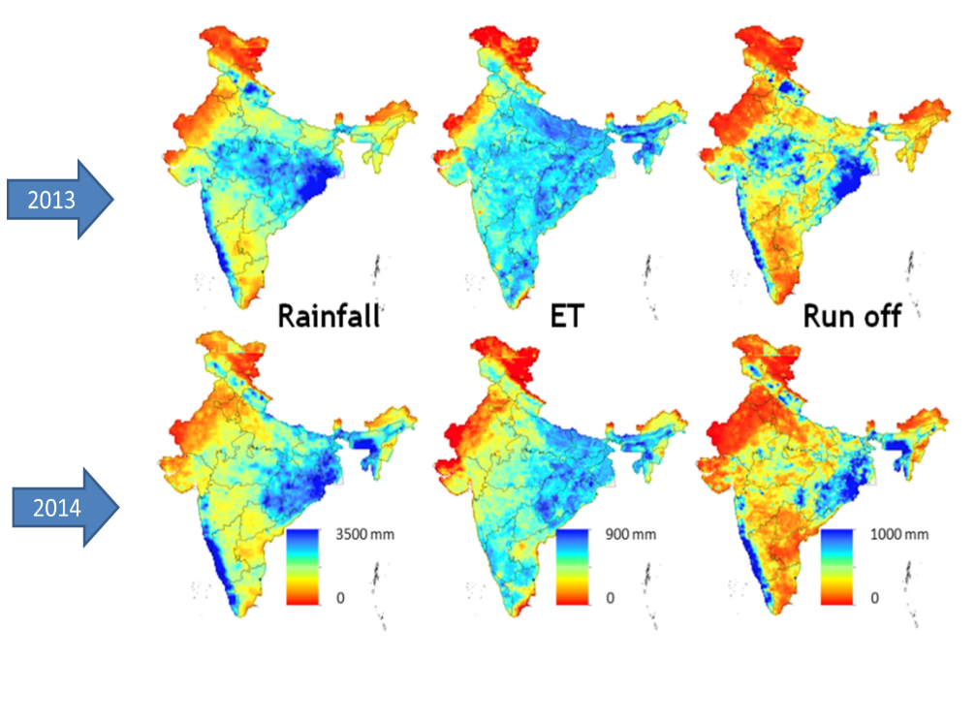
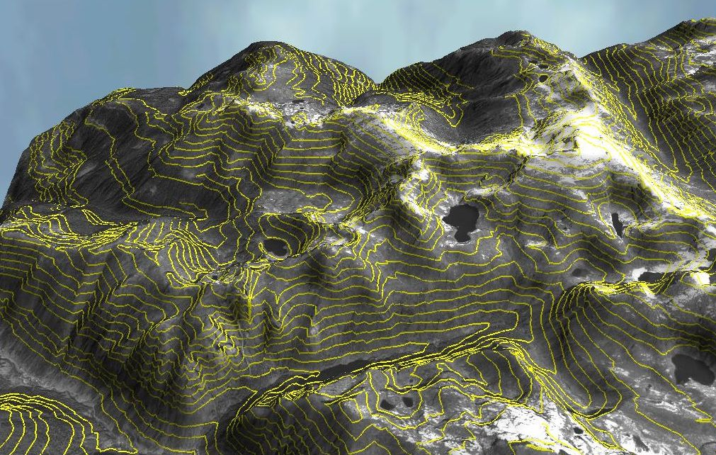
    DEM: 45 M ha ( 0.5m)
    23 M HA (3 m)
  Centralized Procurement of High Resolution DEM
  Centralized procurement of RS products: real time ET
  Centralized arrangement for weather forecast

Slide 42
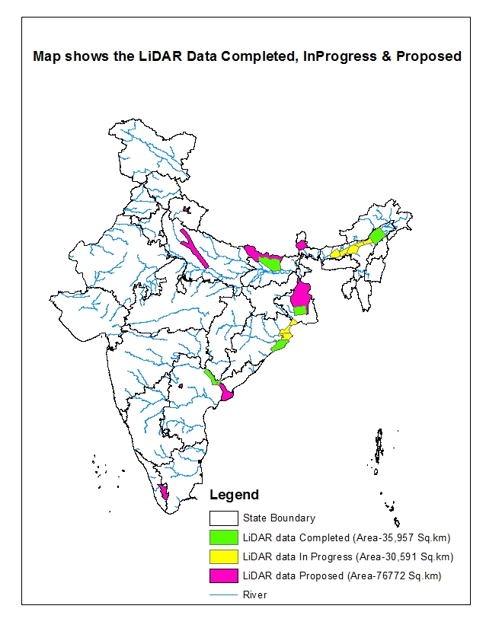
High Resolution Digital Elevation Data Archive Available at NRSC
Spare Capacity for new acquisition
at 15000 sq.km per year

Slide 43
India-WRIS/NWIC
Creation of State Nodes of India-WRIS
Development of Web Services
Support for creation of State-WRIS
Linkages of various models/outputs

Slide 44
NWRIS
MOWR, RD & GR
SOI
Elevation Model
NWIC
IMD
Met & Forecast Data
NRSC
Remote Sense Data
River Basin Data
Centralized Data
India WRIS
(CWC)
Water Resources Agencies and other Water Allied Stakeholders for Application and R&D
CGWB
Ground Water Data
River Basin Data
River Basin Data
CPCB
Water Quality Data
River Basin Data
NIH
Training
River Basin Data
Hydro-met data
River Basin Data
State WRIS
State WRIS
State WRIS

Slide 45
B2.State Water Resources Information System
  The states should follow the IndiaWRIS standards for integration,
  The purpose of State-WRIS is to “serve” and exchange with other stake holders such as Drinking, Agriculture and watershed department.
Development of State-WRIS
Digitization of Water related data

Slide 46
B: Water Resources Information System
  National Products in WRIS/SWRIS
  Access to spatial information including more than 80 layers of IndiaWRIS
  Real time hydromet and reservoir level data.
  High Resolution elevation map for India ranging from (0.5 to 3m)
  Weather forecast (1, 3,5, 7 days and seasonal)
  Macro Water Resources assessment: Rainfall, ET, Runoff estimate
  Remote sensing based estimates for India: Snowmelt, real time ET, land use, irrigation benchmarking,
  Flood forecasting at major stations by CWC

Slide 47
B: Water Resources Information System
  MoWR:
  MoU for integration of data/information from central and state agencies.
  Accessibility system among central and state agencies.
  Linkages with Central agencies for two accessibility.
  CWC:
  Upgrade E-SWIS to monitor irrigation water use, for RTDAS, mobile based manual recording.
  Provide e-SWIS state admin control to states and train.
  Consult with states for Priority of DEM
  Standardization of data structure for IndiaWRIS so that states can also use same
  Provide clarity about the server/software facilities for statesWRIS
  CGWB: Make e-GEMS operational and accessible to all NHP agencies.
  NRSC: Develop training program and procurement of prelim pages
  SoI: Prepare bid document of DEM survey

Slide 48

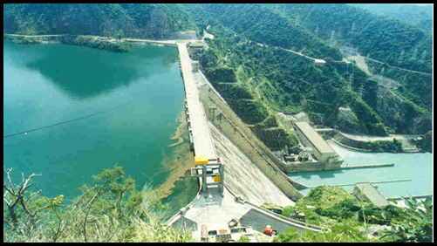
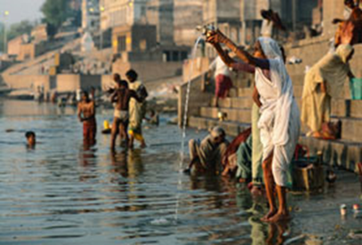
C: Water Resources Operation and Planning
C1. Analytic and DSS Tools
C2.Proposed Driven Studies
C3. Knowledge Products
48

Slide 49
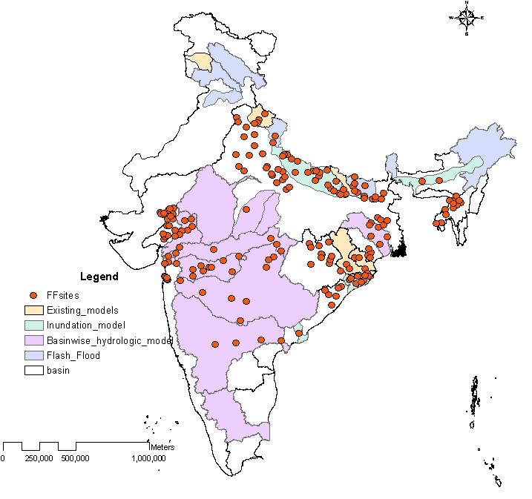
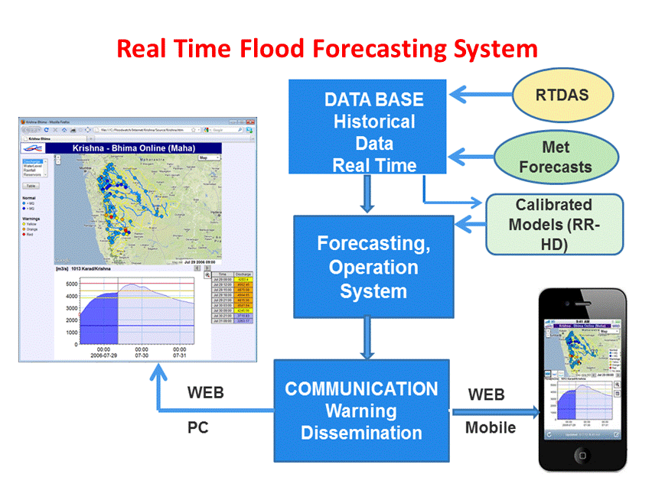
C1. Analytic and DSS Tools
Flood forecasting and early warning system (coupled with Climate forecast)- jointly develop by CWC and Riparian States
CWC : Macro Model will centrally coordinate with all IAs for the development of Macro model; States will simultaneously develop for their respective tributaries.
Initiate procurement of National/ International consultancies to support the development of models at central as well as state levels
49

Slide 50
Basin name | CWC
 | Flood Modelling | DSS for IWRM | Regional Water Availability Model | Sediment Transport Modelling | Aquatic Life Assessment
Area of North Ladakha not draining into Indus Basin
Barak and others Basin |  |  |  | Yes
Brahmani and Baitarni Basin |  |  | Yes
Brahmaputra Basin | Yes |  | Yes |  | Yes
Cauvery Basin | Yes |  | Yes
East flowing rivers between Godavari and Krishna Basin |  |  | Yes
East flowing rivers between Krishna and Pennar Basin |  |  | Yes
East flowing rivers between Mahanadi and Godavari Basin |  |  | Yes
East flowing rivers between Pennar and Cauvery Basin |  |  | Yes
East flowing rivers South of Cauvery Basin |  |  | Yes
Ganga Basin | Yes | Yes |  | Yes
Godavari Basin | Yes | Yes |  |  | Yes
Indus (Up to border) Basin | Yes |  | Yes |  | Yes
Krishna Basin | Yes |  | Yes
Mahanadi Basin | Yes | Yes | Yes | Yes
Mahi Basin | Yes |  | Yes
Minor rivers draining into Bangladesh Basin
Minor rivers draining into Myanmar Basin
Narmada Basin | Yes |  | Yes |  | Yes
Pennar Basin | Yes | Yes | Yes
Sabarmati Basin
Subernarekha Basin | Yes | Yes | Yes
Tapi Basin | Yes | Yes |  | Yes
West flowing rivers of Kutch and Saurashtra including Luni Basin |  |  |  |  | Yes
West flowing rivers South of Tapi Basin |  |  |  |  | Yes

Slide 51
C1. Analytic and DSS Tools
Flood forecasting and Water Resources Assessment Models
CWC will engage a major consultancy for both flood forecasting and WR assessment at Macro level.
States will simultaneously develop similar systems for tributaries with the help of regional Institutes or consultancies. NIH shall depute modelers to each state and will also guide.
During development , States representative should be deputed with CWC. CWC will setup River Basin centers during operation such as:
    - Krishna- Godavari Basin; Hyderabad
    Ganga: Patna, Lucknow
    NE center: Gauwahati
  Engage consultancy and decide the models so that both State and central could integrate their models.
51

Slide 52
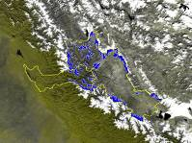
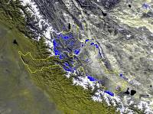
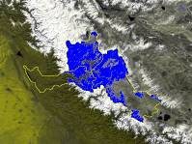
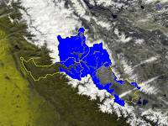





Estimation of snow melt runoff in Himalayas
Seasonal Snow cover changes in Sutlej basin
Objectives
To develop methodology for estimation of snow melt using energy balance approach
To generate a spatial product indicating expected snow melt at each pixel for Himalayas
Nov
Dec
Jan
Feb
Mar
Apr
Deliverables
Generation of spatial snowmelt product for Himalayas (1-2 day)
Snowmelt Runoff at selected river basin outlets
Inflow into Reservoirs
May
Jun
Typical Snow cover across
Himalayas
Snow
Cloud
Snow free

Slide 53

Development of DSS for Irrigation Water Management
Objectives
To develop Decision Support System for irrigation water distribution and management
To enhance irrigation water use efficiency
Deliverables
Cropping pattern and crop progress
Crop condition
In-season irrigation water demand
Optimal irrigation schedule

Slide 54






Glacial Lakes Risk Assessment and Glacial Lake Outburst Flood (GLOF)
Simulations for Priority GL (Ten)
South Lhonak Glacier lake, Sikkim
Growth of the lake as viewed by RS Satellites
Objectives
Glacial Lakes Risk Assessment and Prioritization in Indian Himalayan river basins
GLOF Risk Simulations for Priority Glacial Lakes
Landsat TM, 10-11-1989
Area: 37.32 Ha
IRS 1D, LISS III 17-11-2002
Area: 78.95 Ha
IRS P6, LISS III 17-11-2008
Area: 98.73 Ha
IRS P6, LISS IV 03-07-2012
Area: 102 Ha.
hydrographs (for different depths of lake)
in case of sudden burst of the lake
Highlights
Depth of inundation varies from 3 to 8 m when the discharge is 10,000 m ³/s
Outburst of the lake alone may not cause any flood problem in the area.
Deliverables
Ranking of Glacial of lakes wrt GLOF risk
Simulation of GLOF risk for selected Hazardous GL&WB’s
Possible flood inundation simulation in case of
Sudden failure of the earthen dam (at 10000 m ³/s)

Slide 55
C: Water Resources Operation and Application
  MoWR:
  CWC:
  Prepare TOR for River Basin modelling team and guide the states.
  Recommend flood and water resources assessment model so that states can also plan on developing on similar platform.
  CGWB: Prepare TOR for major procurements.
  NRSC: Develop TOR for major procurements.
  NIH: Guide the states in PDS as the program is very weak.

Slide 56


C: Water Resources Operation and Planning
C3. Groundwater Management
Support National Aquifer Mapping program through innovative systems
Study Surface-groundwater interaction
Community based groundwater monitoring and management
Decision Support System (DSS) for ground water development, management and artificial recharge

Slide 57
C2. Purpose Driven Studies
Specialized studies – R & D component
Some key topics includes:
Dam Break Analysis
Salinity intrusion in costal aquifers
Cloud burst
Glacier Lake Outburst Flood (GLOF)
Reservoir Sedimentation
Water Quality Studies
Irrigation system benchmarking
Effectiveness of groundwater recharging
Impacts of checkdams on flow regime of rivers/ rivulets
NIH will central coordinate with all IAs for the implementation of PDS
Collaboration with reputed national and international research/ academic institutes

Slide 58
D: Institutional Capacity Enhancement
D1. Water Resources Knowledge Centre
D2.Professional Development
D3. Project Management and Technical Assistance
D4: Operating expenses
58

Slide 59
D1. Water Resources Knowledge Centre
  River basin modelling centers (Selective river basins to pilot ):
  - Krishna
  - Mahanadi
  - Damodar
  - ??
  Groundwater modelling center (Selective region/issue):
  - Hardrock – AP/Telangana
  - Alluvial ??
  Centre of Excellent for Water Management
    - North East Centre of Excellent for Water – Guwahati
    - ??
Facilitate knowledge exchange:
  - With internationally reputed Institutes
  - States may consider reforming WALMIs/IMTI

Slide 60
D2.Professional Development
Capacity building
NIH will conduct generic water management courses on annual basis in collaboration with CWC, CWPRS, IMD, NRSC, CGWB. Annual Training calendar will be prepared at the start of each financial year.
States with design customized training program based on their needs and issues.
National/ international tours will be conducted for cross-learning
Collaboration will be done with reputed academic institutions (national/ international)
NHP will support specialized degree program/certificate courses.
Focus will also be made on development of web-based training course.
Staff Assignment
Assign the staff who is interested in Hydrology and water management
Continuity of staff should be ensured otherwise capacity building goes waste.

Slide 61
PROPOSED INSTITUTIONAL CONCEPT
NRSC
National Water Informatics Centre
(within CWC)
National Centre of Excellence
IMD
Data Exchange
Training and R&D
India-WRIS
Technical Collaboration
SoI
Data Exchange
Technical Collaboration
State Data Centre/ State Hydro Informatics Centre
State chapter of India-WRIS(website)
State WR e-library
WR Planning & Applications
State Centre of Excellence
STATE RESEARCH & TRAINING CENTRE or
WALMI or Local University
Collaboration with International/National Research Organization & Universities
District Data Centre
Data sharing
Technical Collaboration
Training and R&D
Data exchange
Data exchange
Agriculture Dept.
PHED
Environment Dept.
Disaster Management

Slide 62
NATIONAL HYDROLOGY PROJECT (NHP)
INSTITUTIONAL IMPLEMENTATION ARRANGEMENTS
National Level Steering Committee (NLSC) Chaired by Secretary
NHP Financial Review Committee
Chair: Addl. Secretary
NHP Technical Review Committee
Chair: CWC, Chairman
NHP
International
Advisor Committee
NHP
Technical & Management Consultant (TAMC)
Central Project Management Unit (CPMU)
Headed by Joint Secretary
Component A:
Water Resources Data Acquisition Systems (WRDAS)
Component B:
Water Resources Information System (WRIS)
Component C:
Water Resources Operation & Planning (WROP)
Component D:
Institutions Capacity Enhancement (ICE)
Coordinating Agencies
Coordinating Agencies
Coordinating Agencies
Coordinating Agencies
(A) WRDAS: CWC, WPRS & IMD
(A) Maps & DEM:
SOI
(A) Surface Water:
CWC
(A) In country Training: NIH
(B) Centralized Database: CWC
(B) Remote Sensing Applications: NRSC
(B) Ground Water: CGWB
(B) International Training: CPMU
(C) Data Collation:
CWC & CGWB
(C) India-WRIS:
CWC
(C) PDS & R&D:
NIH
(C) Institutional Development: CPMU

Slide 63
NATIONAL HYDROLOGY PROJECT (NHP)
INSTITUTIONAL IMPLEMENTATION ARRANGEMENTS
National Level Steering Committee (NLSC)
Chaired by Secretary, MoWR,RD & GR
NHP Financial Review Committee
(NHP-FRC)
Chaired by Addl Secretary, MOWR, RD & GR
NHP Technical Review Committee
(NHP-TRC)
Chaired by Chairman, CWC
NHP
International
Advisor Committee
Central Project Management Unit (CPMU)
Headed by Joint Secretary (Admin)
NHP
Technical and Management Consultant (TAMC)
Coordinators of Central Agencies
CWC, CGWB, NIH, CWPRS, CPCB, SOI, IMD,NRSA,
River Basin Organization
BBMB & DVC
Technical Consultant:
CWC – River Basin Modelling
CWPRS – Hydro-met Consultant
SOI – Lidar Survey
State Level Project Steering Committee (SLPSC)
Chaired by Secretary, WRD
NHP-State Project Review Committee (NHP-SPRC)
Chaired by CE/Director
Nodal Officers of Central Agencies (PIUs)
CWC, CGWB, NIH, CWPRS, CPCB, SOI, IMD,NRSA, BBMB, DVC
State Project Management Unit (SPMU)
Headed by SE/Project Director
State Level Support Consultants

Slide 64
Central Project Management Unit (CPMU)
MoWR, RD & GR
Joint Secretary
Director-MoWR*
* Full time position
Technical
Section
Administrative
Section
Finance
Section
Procurement
Section
M & E
Section
Project Technical & Management Consultant (TAMC)
Hydrologist (Director – CWC)
Hydro-geologist (Sr. Hydro-Geologist – CGWB)
Instrumentation Expert (CWPRS)
Research & Training Expert (NIH)
Finance Officer/ Accounts Officer
Assistant Accounts Officer
Sr. M & E (Dy Director)
M& E Expert
MIS Expert
Team Leader
Instrumentation Expert
Telemetry Expert
SCADA Expert
Hydrologist
Flood Management Expert
Hydro Informatics Expert
Hydro-geologist
Training Expert
Finance Specialist
Procurement Specialist
Team Assistants
M& E Expert
MIS Expert
Under Secretary /Section Officer
Upper Division Clerk
Lower Division Clerk
Computer Operator/ Data Entry
Office Assistant
Procurement Expert

Slide 65
Central Project Management Unit (CPMU)
MoWR, RD & GR
Joint Secretary
Director-MoWR*
* Full time position
Technical
Section
Administrative
Section
Finance
Section
Procurement
Section
M & E
Section
Project Technical & Management Consultant (TAMC)
Hydrologist (Director – CWC)
Hydro-geologist (Sr. Hydro-Geologist – CGWB)
Instrumentation Expert (CWPRS)
Research & Training Expert (NIH)
Finance Officer/ Accounts Officer
Assistant Accounts Officer
Sr. M & E (Dy Director)
M& E Expert
MIS Expert
Team Leader
Instrumentation Expert
Telemetry Expert
SCADA Expert
WRM Specilist
Flood Management Expert
Hydro Informatics Expert
Hydro-geologist
Training Expert
Finance Specialist
Procurement Specialist
Team Assistants
M& E Expert
MIS Expert
Under Secretary /Section Officer
Upper Division Clerk
Lower Division Clerk
Computer Operator/ Data Entry
Office Assistant
Procurement Expert

Slide 66
Tentative Fund flow System
(MoWR to confirm)
World Bank
State
(with counterpart funding)
RBO/
Non-MoWR organizations
(Grant in aid)
Central Organization
MoWR,
RD&GR
CAAA
Fund flow mechanism from MoWR to states needs to be simplified to ensure timely release of funds.
States are advised to work with MoWR to develop the procedures

Slide 67
Fund Allocation Component-wise
S.No |  |  | Component-wise
 | Implementing Agency | Amount Allocated (INR Cr) | A | B | C | D
 | STATES
1 | Andhra Pradesh (GW) | 80.00 | 48.00 | 4.00 | 12.00 | 16.00
2 | Andhra Pradesh (SW) | 80.00 | 48.00 | 4.00 | 12.00 | 16.00
3 | Assam | 47.00 | 28.20 | 2.35 | 7.05 | 9.40
4 | Bihar (GW) | 30.00 | 18.00 | 1.50 | 4.50 | 6.00
5 | Bihar (SW) | 105.00 | 63.00 | 5.25 | 15.75 | 21.00
6 | Chattishgarh SW | 48.00 | 28.80 | 2.40 | 7.20 | 9.60
7 | Chattishgarh GW | 32.00 | 19.20 | 1.60 | 4.80 | 6.40
8 | Goa | 68.00 | 40.80 | 3.40 | 10.20 | 13.60
9 | Gujarat (GW) | 31.00 | 18.60 | 1.55 | 4.65 | 6.20
10 | Gujarat (SW) | 70.00 | 42.00 | 3.50 | 10.50 | 14.00
11 | Haryana (SW) | 50.00 | 30.00 | 2.50 | 7.50 | 10.00
12 | Himachal Pradesh | 70.00 | 42.00 | 3.50 | 10.50 | 14.00
13 | Jharkhand | 60.00 | 36.00 | 3.00 | 9.00 | 12.00
14 | Karnataka (SW) | 110.00 | 66.00 | 5.50 | 16.50 | 22.00
15 | Kerala (GW) | 40.00 | 24.00 | 2.00 | 6.00 | 8.00
16 | Kerala (SW) | 42.00 | 25.20 | 2.10 | 6.30 | 8.40
17 | Madhya Pradesh | 90.00 | 54.00 | 4.50 | 13.50 | 18.00
18 | Maharashtra (GW) | 36.00 | 21.60 | 1.80 | 5.40 | 7.20
19 | Maharashtra (SW) | 150.00 | 90.00 | 7.50 | 22.50 | 30.00
20 | Manipur | 25.00 | 15.00 | 1.25 | 3.75 | 5.00
21 | Meghalaya | 25.00 | 15.00 | 1.25 | 3.75 | 5.00
22 | Mizoram | 31.00 | 18.60 | 1.55 | 4.65 | 6.20
23 | Nagaland | 28.00 | 16.80 | 1.40 | 4.20 | 5.60

Slide 68
Fund Allocation Component-wise
S no. |  |  | Component-wise
 | Implementing Agency | Amount Allocated (INR Cr) | A | B | C | D
 | STATES
24 | Odisha (GW) | 55.00 | 33.00 | 2.75 | 8.25 | 11.00
25 | Odisha (SW) | 60.00 | 36.00 | 3.00 | 9.00 | 12.00
26 | Punjab | 74.00 | 44.40 | 3.70 | 11.10 | 14.80
27 | Rajasthan | 128.00 | 76.80 | 6.40 | 19.20 | 25.60
28 | Sikkim | 25.00 | 15.00 | 1.25 | 3.75 | 5.00
29 | Tamil Nadu | 100.00 | 60.00 | 5.00 | 15.00 | 20.00
30 | Telangana (GW) | 70.00 | 42.00 | 3.50 | 10.50 | 14.00
31 | Telangana (SW) | 97.00 | 58.20 | 4.85 | 14.55 | 19.40
32 | Tripura | 25.00 | 15.00 | 1.25 | 3.75 | 5.00
33 | Uttar Pradesh(GW) | 50.00 | 30.00 | 2.50 | 7.50 | 10.00
34 | Uttar Pradesh (SW) | 121.00 | 72.60 | 6.05 | 18.15 | 24.20
35 | Uttarkhand | 75.00 | 45.00 | 3.75 | 11.25 | 15.00
36 | West Bengal (GW) | 50.00 | 30.00 | 2.50 | 7.50 | 10.00
37 | West Bengal (SW) | 100.00 | 60.00 | 5.00 | 15.00 | 20.00
 | UTs
38 | Delhi | 5.00 | 3.00 | 0.25 | 0.75 | 1.00
39 | Puducherry | 20.00 | 12.00 | 1.00 | 3.00 | 4.00
 | River Basin Organization
40 | Bhakra Beas Management Board (BBMB) | 30.00 | 10.00 | 2.00 | 12.00 | 6.00
41 | Damodar Valley Corporation (DVC) | 50.00 | 30.00 | 2.50 | 7.50 | 10.00

Slide 69
Fund Allocation Component-wise
 |  |  | Component-wise
 | Implementing Agency | Amount Allocated (INR Cr) | A | B | C | D
 | CENTRAL AGENCIES
42 | Ministry of Water Resources, River Development & Ganga Rejuvenation (MoWR,RD & GR) | 140.00 | 0.00 | 0.00 | 0.00 | 140.00
43 | Central Water Commission(CWC) | 265.00 | 25.00 | 35.00 | 155.00 | 50.00
44 | Central Ground Water Board (CGWB) | 75.00 | 7.00 | 23.00 | 35.00 | 10.00
45 | National Institute of Hydrology (NIH) | 75.00 | 0.75 | 0.00 | 25.50 | 48.75
46 | Central Water & Power Research Station (CWPRS) | 60.00 | 10.00 | 0.00 | 2.00 | 48.00
47 | Central Pollution Control Board (CPCB) | 26.00 | 22.00 | 1.00 | 0.00 | 3.00
48 | India Meteorological Department (IMD) | 100.00 | 40.00 | 30.00 | 0.00 | 30.00
49 | Survey of India (SOI) | 300.00 | 0.00 | 250.00 | 0.00 | 50.00
50 | National Remote Sensing Agency(NRSA) | 80.00 | 0.00 | 55.00 | 10.00 | 15.00
The allocations to components will remain fix however there is enough flexibility among the components to accommodate various needs.
Reallocation will be done during MTR. Performing IAs will get additional fund

Slide 70
A: Lessons Learnt and NHP Design
S.No. | Activity | HP1 | HP2 | NHP
1. | Hydromet system | Since the system introduced were completely new, centralized procurement was practiced, | Decentralized procurement. | Introduce Framework agreement to simplify technical evaluation by central
 |  | The ownership, commissioning and AMC were major challenge | Technical evaluation was very challenging and many could not complete in time. | Quality control arrangement: MoWR: Installation CWC: Data
2 | AMC | Many times, systems failed due to no replacement of batteries… | 2 year warranty and 5 years AMC were introduced with consumable however, the service standards are challenging in some cases. The state who did not opt for AMC are struggling with the defunc systems. | More improvements in payment stages and others. CMC must. There are proposal to have warranty or equivalent for longer period linkage with the manufacturers.

Slide 71
A: Lessons Learnt and NHP design
S. No. | Activity | HP1 | HP2 | NHP
6 | Installations |  | Both states and Vendor did not have enough trained staff. | Ambitious training program across the country, already more than 100 are trained through Bank sponsored training. IAs are advised to train as many engineers possible.
 |  |  | Some theft of solar systems/batteries are being reported in real time Hydromet. | Working on various options including making manual data reliable with mobile based technology.
7 | Contract management | Centralized so state did not have significant role | IAs have not been able to take action against the vendor while contract did have provision for penalties. | Train the staff rigorously so that they are able to monitor from the beginning. MOWR needs to ensure support and monitoring.
8 | Softwares | Desktop based standardized softwares were procured which lead to high AMC requirement and compatibility issues later | Web-based systems were introduced through central agencies but States are not comfortable to join Some system did not complete and have left all the states waiting for it. | Web-based system with improved administrative control to states.

Slide 72
A: Lessons Learnt and NHP design
S. No. | Activity | HP1 | HP2 | NHP
 | Software system |  | In some case Software development and hardware were kept different that resulted in delays. | Advising IAs to go for cloud server at once for all and use hardware as offline backup.
 |  |  | Licensed softwares limited the usage and continuity. | Project will prefer the license-free software to encourage wide usage.
 |  |  | Software developments took time | Look for off the shelf softwares if available.
9 | Server |  | Hard disc which are difficult to maintain and mostly no back up due to which data may get lost. More prone to Damages and cyber security and difficult to upgrade. | Go for Cloud server and have Hard disc server as backup.
10 | Staffing |  | Large turnover in some states | Collaborate with the regional Institutes to run the training program and perhaps support technically also.

Slide 73
A: Lessons Learnt and NHP design
S. No. | Activity | HP1 | HP2 | NHP
9 | Data Accessibility | Data policy promoted pricing. | Free and Real time online | NWRIS with integrated database and “free” accessibility
10 | Post project | AMC and operation were not funded which affected systems | Some states and Central agencies have experienced challenges in completing or continuing the activities introduced during the project. | MoWR is requested to perhaps continue NHP as program. The annual requirement to run the project all over India would be hardly in the range of INR 300 crore /year.

Slide 74
Summary and conclusions
  MoWR
  EFC clearance.
  Devise fund flow system from MoWR to states which would ensure the fund availability by March of each year (State indicated that under current central assistance, the first installment is made available only by Sep-Oct).
  Initiate procurement of TAMC to have it in place by effectiveness of project.
  MoUs for Data sharing with IAs.

Slide 75
DEA Readiness by Dec 2015
MoWR: Engage consultancy for Technical and management
CWC: Framework Agreement, Rate contract for Hydromet
CWC: River basin Modelling Consultancy
SoI: Bid for DEM survey

Slide 76
'If You Can't Measure It, You Can't Manage It‘
Thank you
agaur@worldbank.org

Slide 77
NATIONAL HYDROLOGY PROJECT (NHP) : Total 48 IMPLEMENTATION AGENCIES
Central Agencies :
Ministry of Water Resources, River Development and Ganga Rejuvenation (MoWR, RD & GR)
Central Water Commission (CWC)
Central Ground Water Board (CGWB)
Central Water and Power Research Station (CWPRS)
National Institute of Hydrology (NIH)
Indian Meteorological Department (IMD)
Central Pollution Control Board (CPCB)
Survey of India (SOI)
National Remote Sensing Agency (NRSA)
River Basin Agencies
Damodar Valley Corporation (DVC)
Bhakra-Beas Management Board (BBMB)
States/UTs (Old):
Andhra Pradesh
Chhattisgarh
Himachal Pradesh
Goa
Gujarat
Madhya Pradesh
Maharashtra
Karnataka
Kerala
Odisha
Puducherry
Punjab
Tamil Nadu
States/UTs (New):
Assam
Bihar
Haryana
Jharkhand
Manipur
Meghalaya
Mizoram
Nagaland
Rajasthan
Sikkim
Telangana
Tripura
Uttar Pradesh
Uttarkhand
West Bengal

